Slide 1
Chair’s meeting
September 28, 2021

Slide 2
Agenda
Welcome
Meet the new cabinet members
Meet the ACAF staff
Sabbatical planning
Spring curriculum planning
Assessment and reaccreditation
Pandemic planning and policies
Conversation with the President

Slide 3
Meet the New Cabinet Members
Amin Gonzalez
Vice President and Dean of Admission and Financial Aid
Frantz Williams
Vice President for Advancement
Renell Wynn
Vice President for Communications

Slide 4
Meet the ACAF Staff
Sterling Berry-Whitlock, Faculty Employment Specialist (visiting faculty)
Megan Flagg, Executive Assistant to the Provost
Lisa Sacks, Assistant Director for Curricular Initiatives
Joy Vodak, Associate Director
Maureen Zimmer, Faculty Employment Specialist (grid faculty)

Slide 5
Sabbatical Planning
The Sabbatical chart is a report of the accumulated semesters towards eligibility to apply for a sabbatical. The Advisory Committee is reviewing a proposal from the ad hoc committee on reappointment and promotion for continuing, non-tenure track faculty. Currently, Adjunct and Professors of the Practice can apply for sabbatical on an ad hoc basis, although we anticipate a change in the policy shortly. They are listed on the sabbatical chart to indicate when they had their last sabbatical.
A complete application includes a description of the intended purpose and anticipated result of the sabbatical and/or leave, as well as the report from the last sabbatical/leave
Chair reviews applications and forwards to Maureen Zimmer with a proposal making a recommendation and justification of which faculty should be approved for sabbatical or unpaid leave
October 13 – Applications due to Maureen
November 1– Approvals will be sent to faculty

Slide 6
Spring Course Planning
Pre-Covid Standard Meeting Times are back
With PAC closure, classroom space is limited.
      All departments/centers/programs are asked to redistribute Spring 2022 course offerings to comply with 20-40-40 distribution
New “Room Seek” and “View by Room” features in CourseLeaf CLSS.
Curriculum Development will likely open in January this year and close at the end of February.

Slide 7
Assessment & Accreditation
Emailed all chairs last week
Responded to AY20-21 annual report
Big Ask – looking for info for NECHE self-study
Big Idea – what can I do for you?

Slide 8
Assessment & Accreditation
E Series
Must do for all for departments, programs, colleges that offer a degree
Four questions
      Goals posted?
      What evidence?
      Who reviews?
      Changes made?
Text of Standard 8
Specific units get profiled
Emphasis on those that have made changes based in data/evidence/info collected

Slide 9
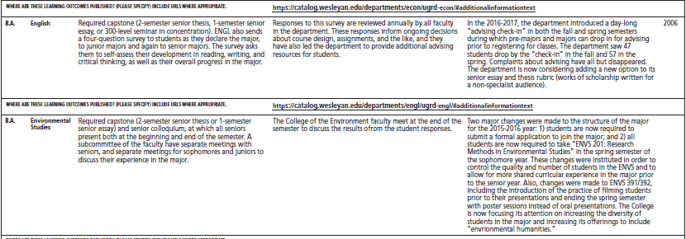
E-Series example (2017)
Who interprets the data/evidence?
Other than grades, what other data/evidence used to determine that graduates have achieved desired outcomes?
Who interprets the data/evidence?

Slide 10
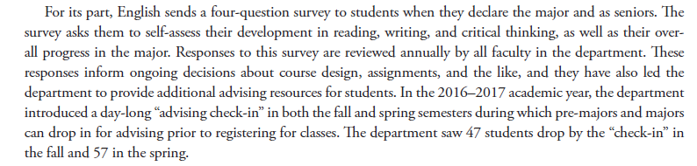
Text of Standard 8 example (2017)

Slide 11
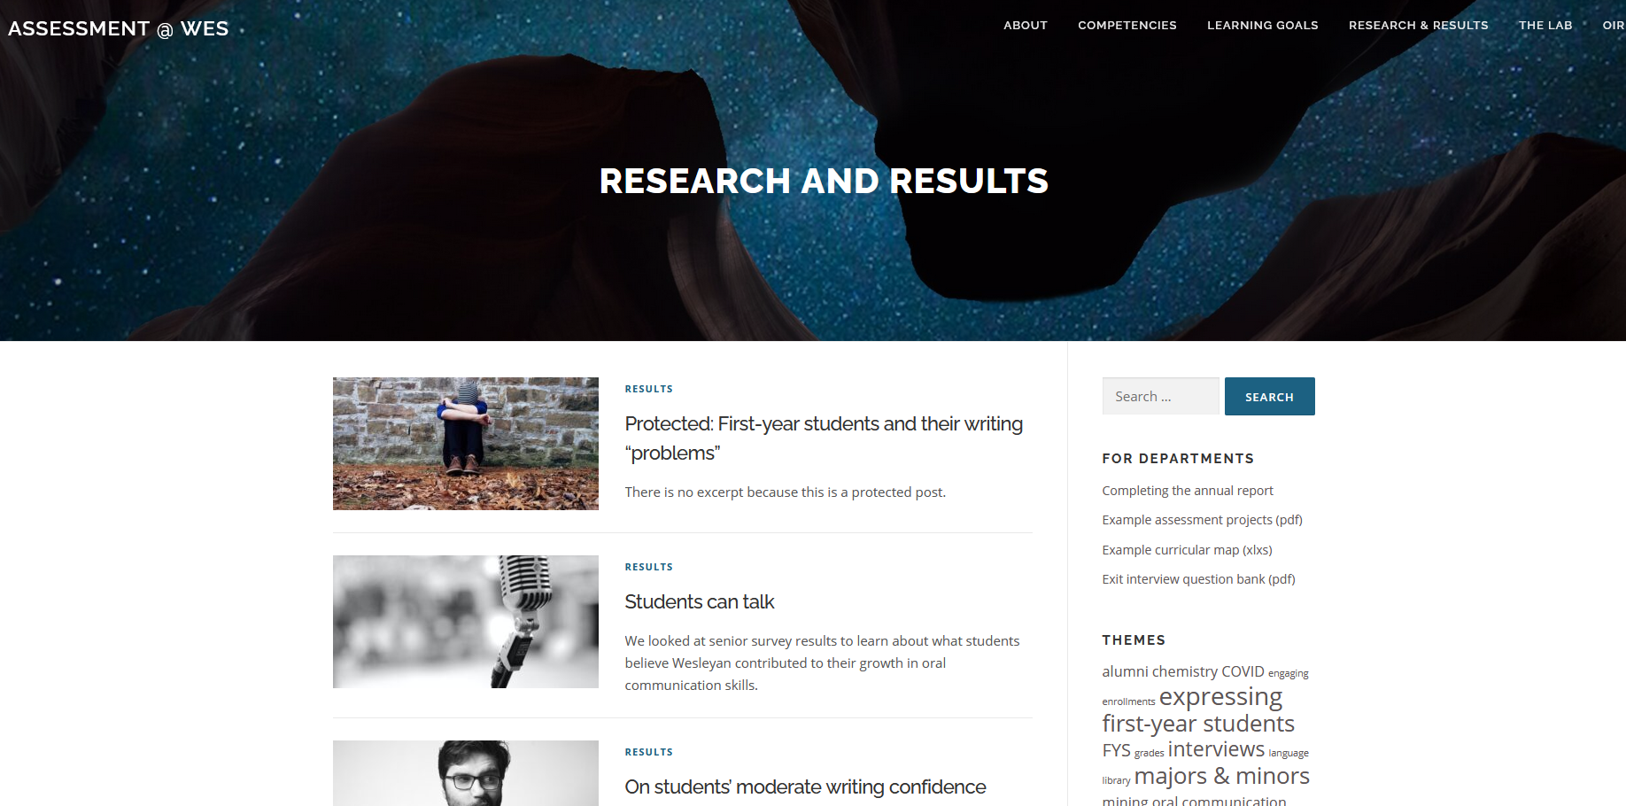

Slide 12
Pandemic Planning and Policies
Rick Culliton, Associate Vice President and Dean of Students
Dr. Tom McLarney, Medical Director
Bill Nelligan Director, Environmental Services
Mike Conte, Director of Physical Plant Operations

Slide 13
Conversation with the President
Michael Roth, President

Slide 14
Thank you!
Upcoming meeting:
    Tuesday, November 23, 11:50am – 1:10pm

